Slide 1


Adding System Call to Kernel
Linux
January 8, 2019
Jeyeon Lee
Dept. of Software
Dankook University
2reenact@naver.com

Slide 2
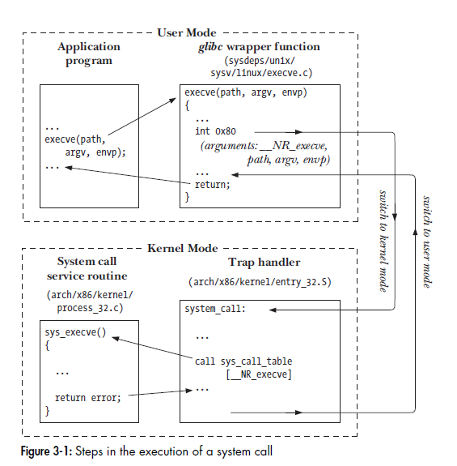

System Calls
What is System Call?
Steps when they occur on a Hardware (x86-32)
The program makes a system call by invoking a wrapper function
Since System call trap-handling routine expects arguments in specific registers. they are copied to specific registers
System call number is copied into a specific CPU register
The wrapper function executes a trap machine instruction
The kernel invokes its system_call() routine
Saves register values onto the kernel stack
Checks the validity of the system call number
Invoke the appropriate system call service routine
Restore register value
Return to wrapper function and user mode

Slide 3
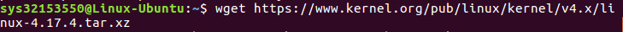
Adding System Call (1/5)
Download the kernel source
in ubuntu 16.04 version use kernel 4.17.4
Download the kernel source from www.kernel.org
use wget
Extract the kernel source code
use tar (store & extract files from a tape or disk archive)
-x : extract files from an archive
-v : requested using the –verbose option, when extracion
-f : file archive; use archive file or device archive
-C : extract to the directory specified after it

Slide 4
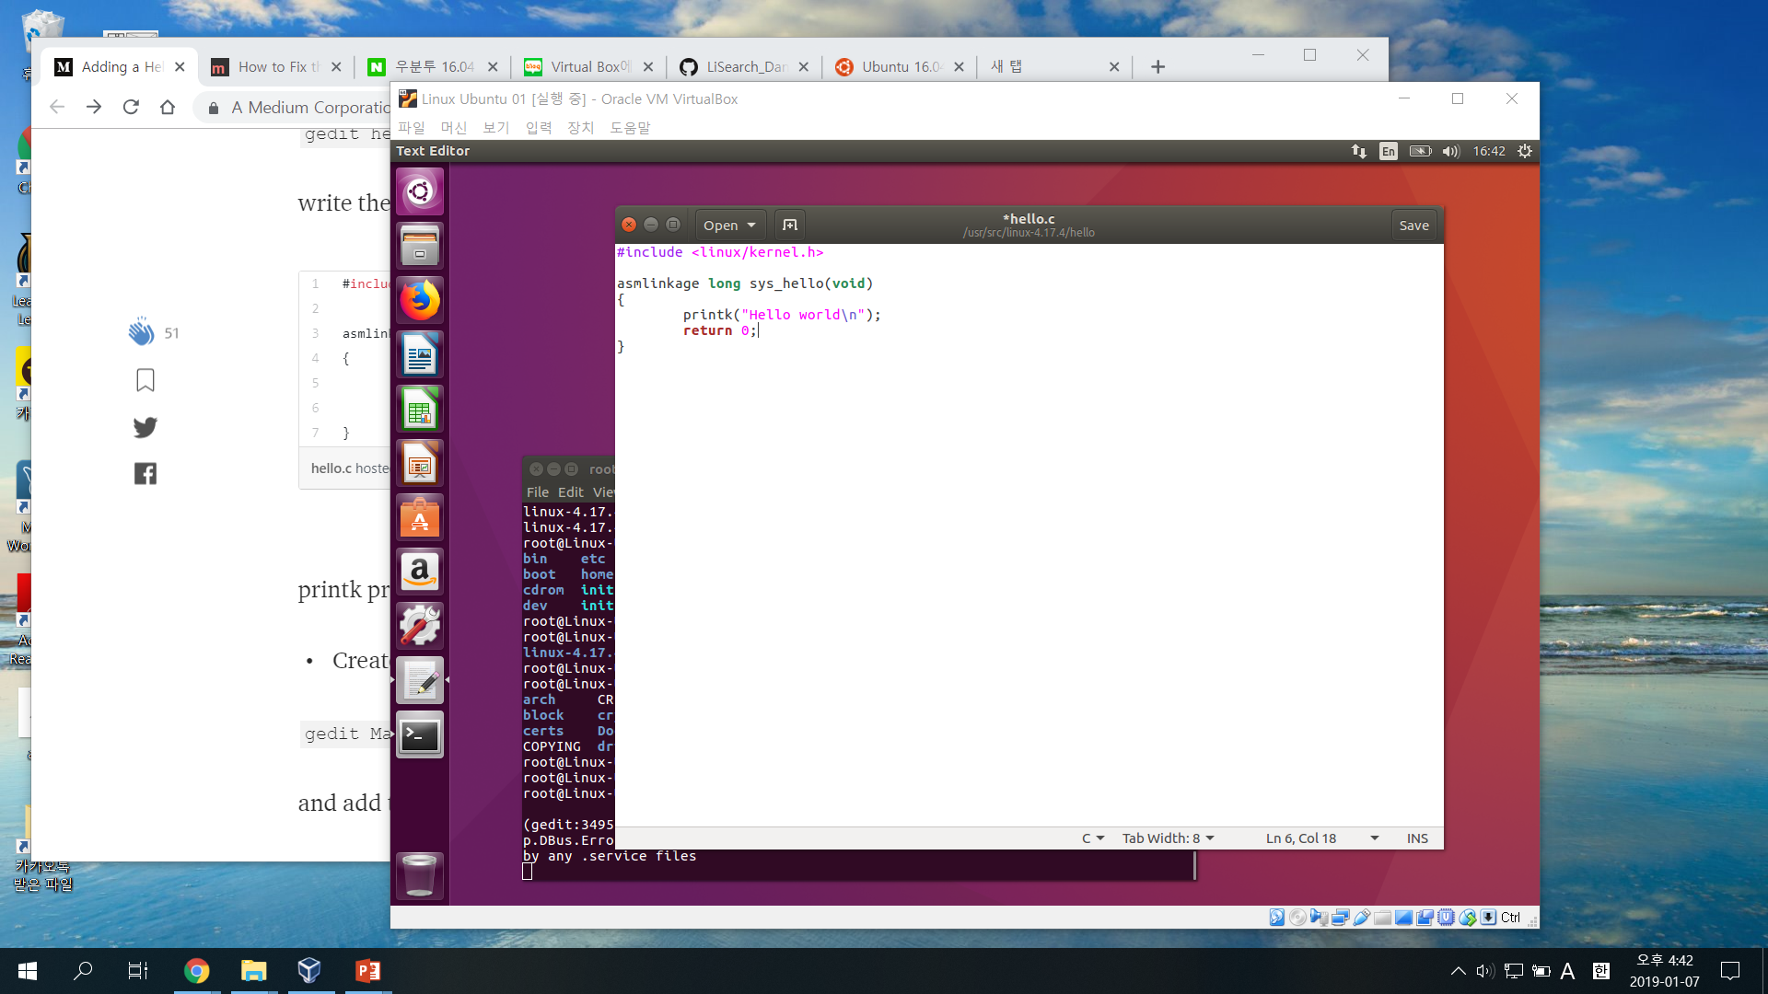
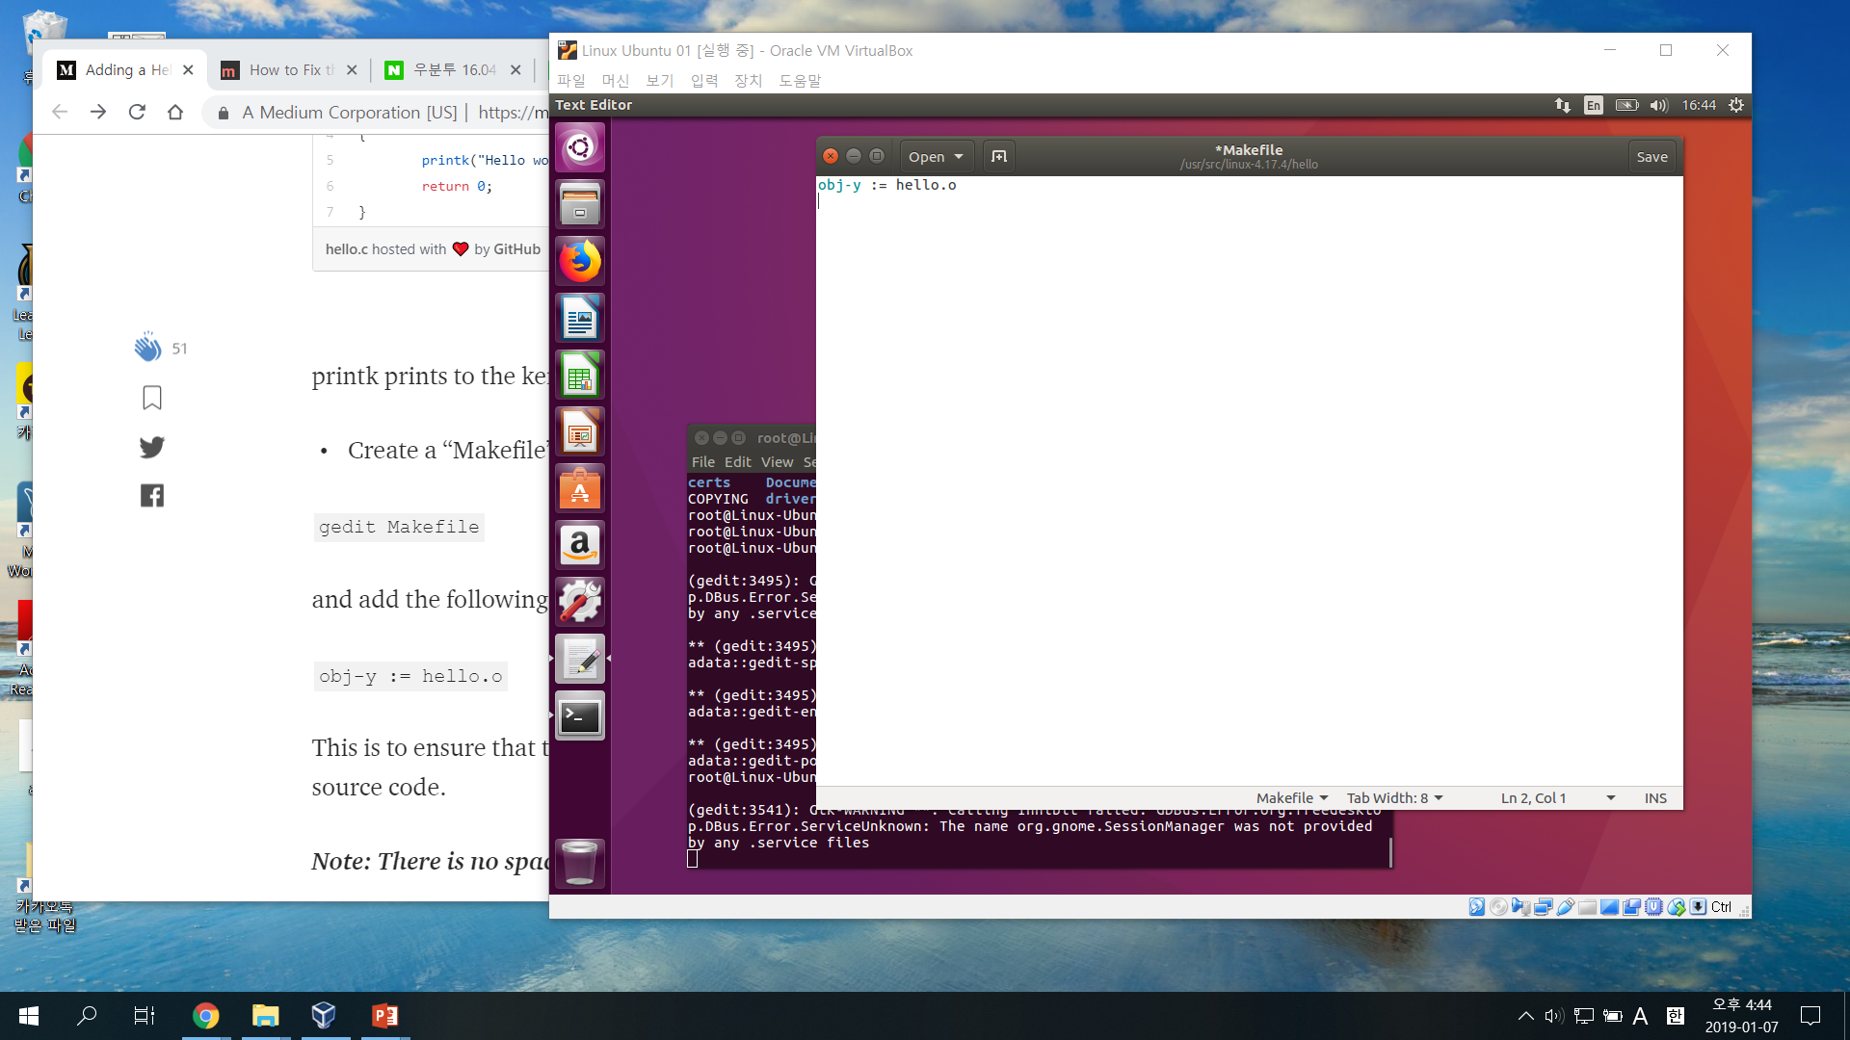
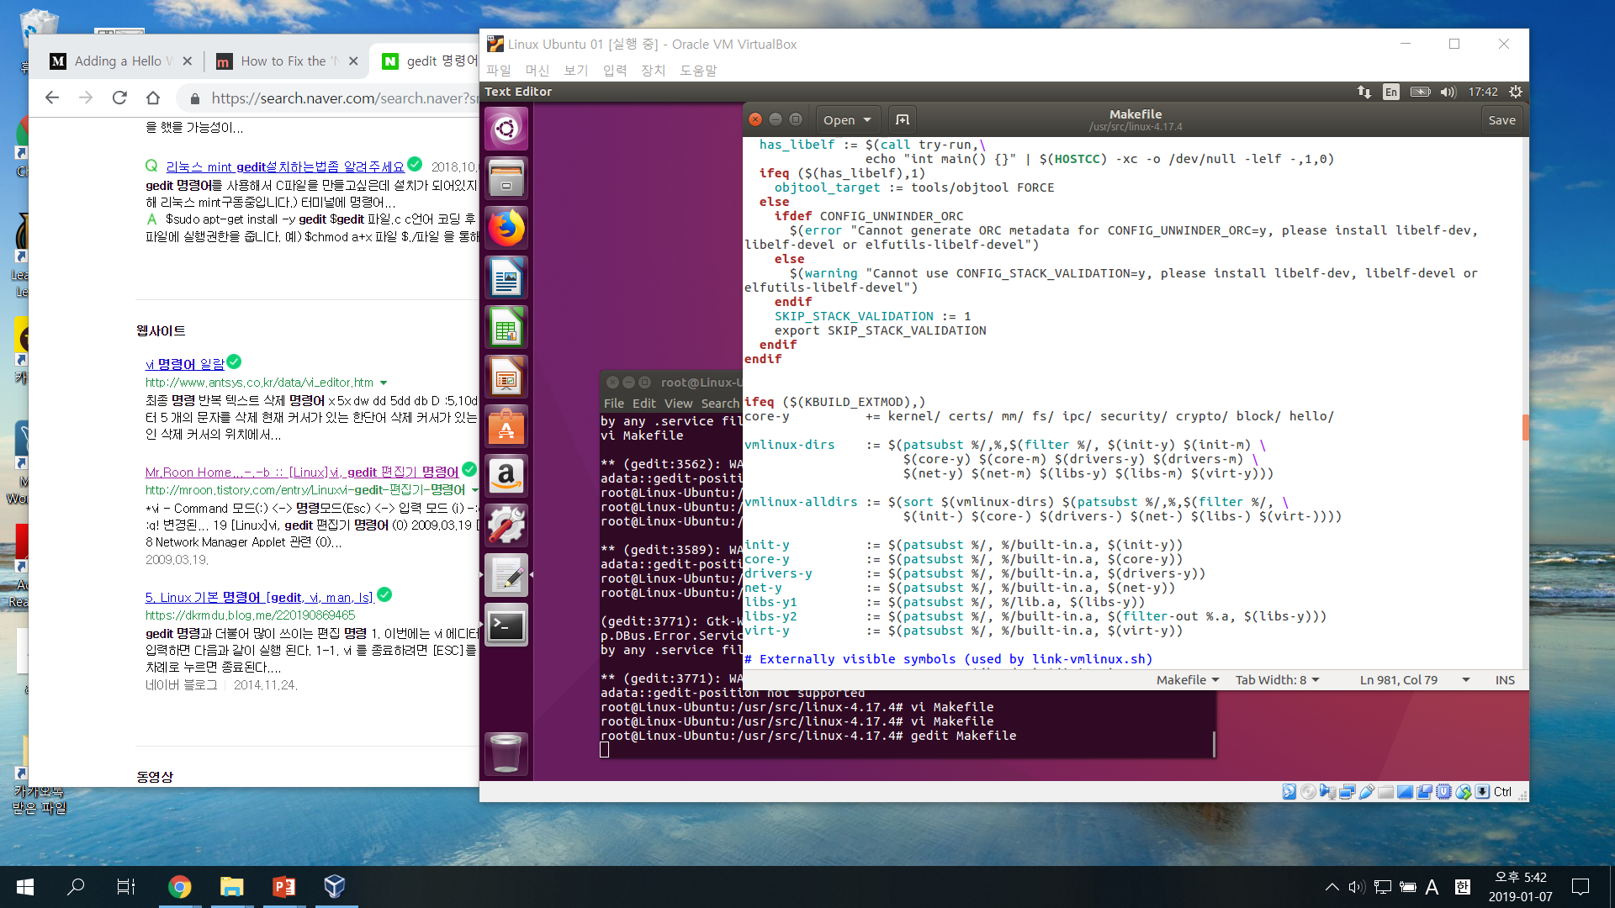
Adding System Call (2/5)
Define a new system call sys_hello()
Create hello.c & Makefile in hello directory
use mkdir
Add hello/ to the kernel’s Makefile
core-y += kernel/ mm/ fs/ ipc/ security/ crypto/ block/

Slide 5
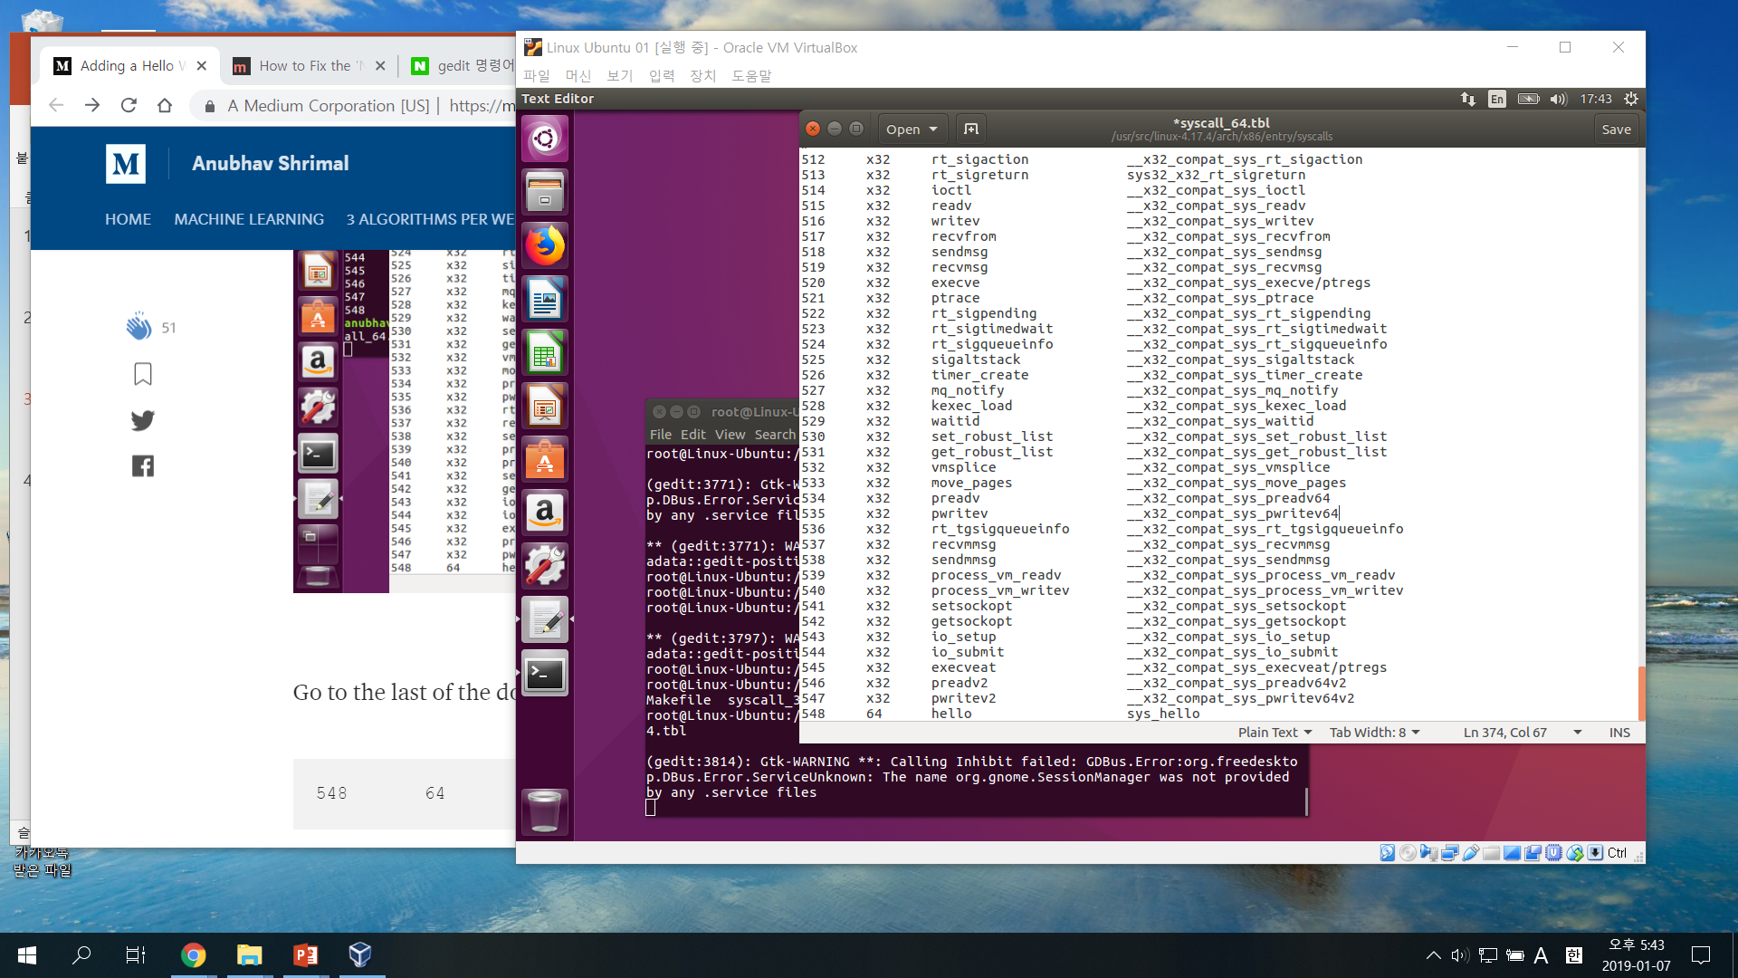
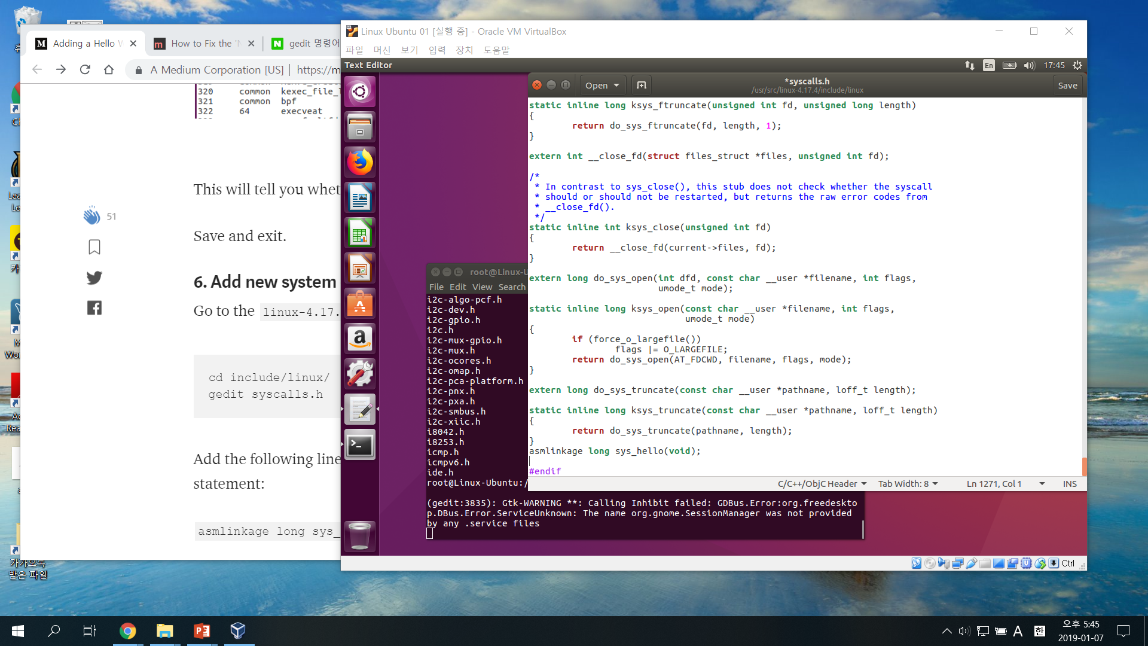
Adding System Call (3/5)
Add the new system call to the system call table
syscall_64.tbl in arch/x86/entry/syscalls/
We get the number of the system call
Add new system call to the system call header file
syscalls.h in include/linux/

Slide 6
Adding System Call (4/5)
Compile & Update kernel
install a few packages with command : install
gcc : gnu compiler collection
libncurses5-dev : terminal processing library
bison : parser generator for an annotated context-free grammer
flex : fast lexical analyzer generator
libssl-dev : socket layer toolkit
libelf-dev : provides library which allows read & write on ELF files

Slide 7
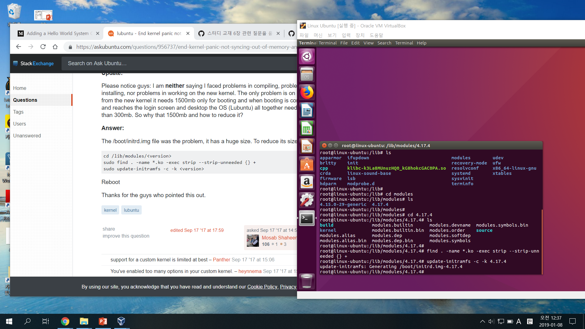
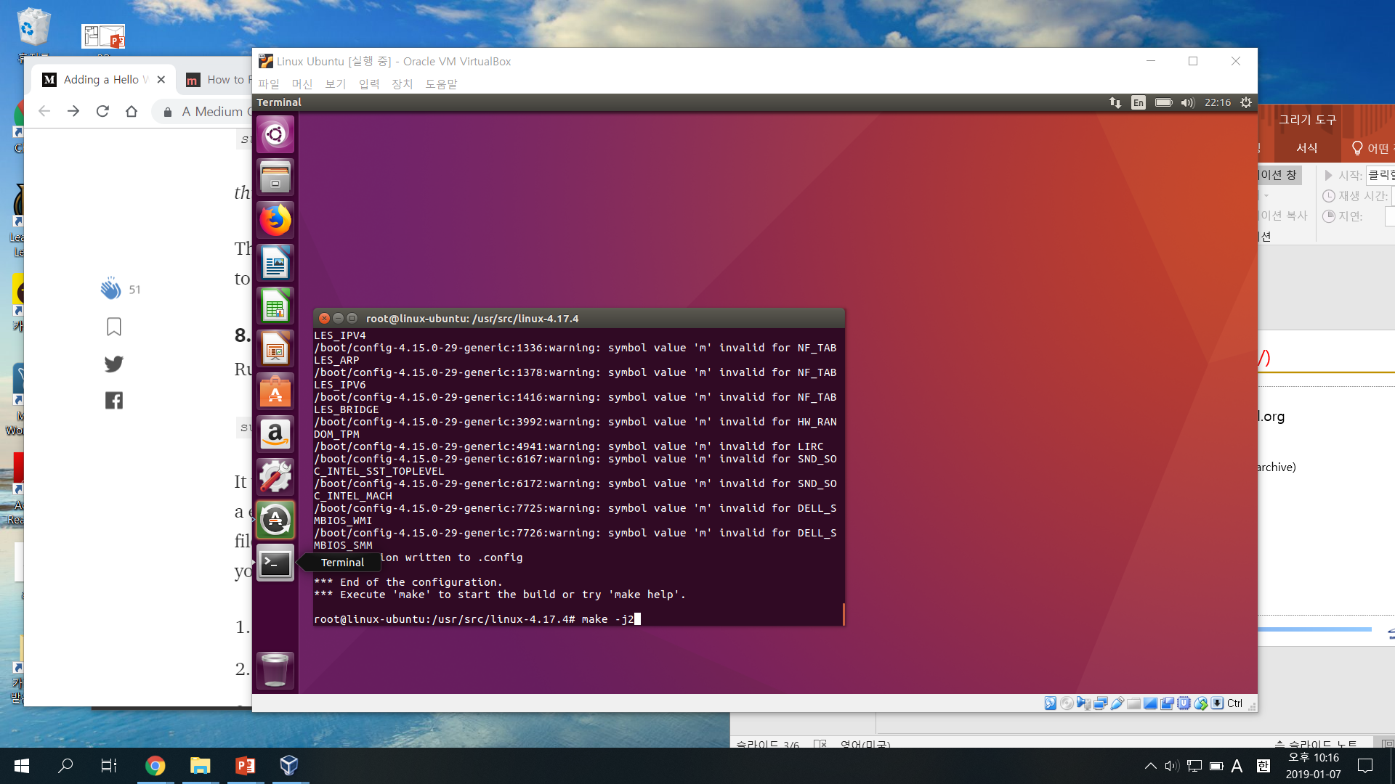
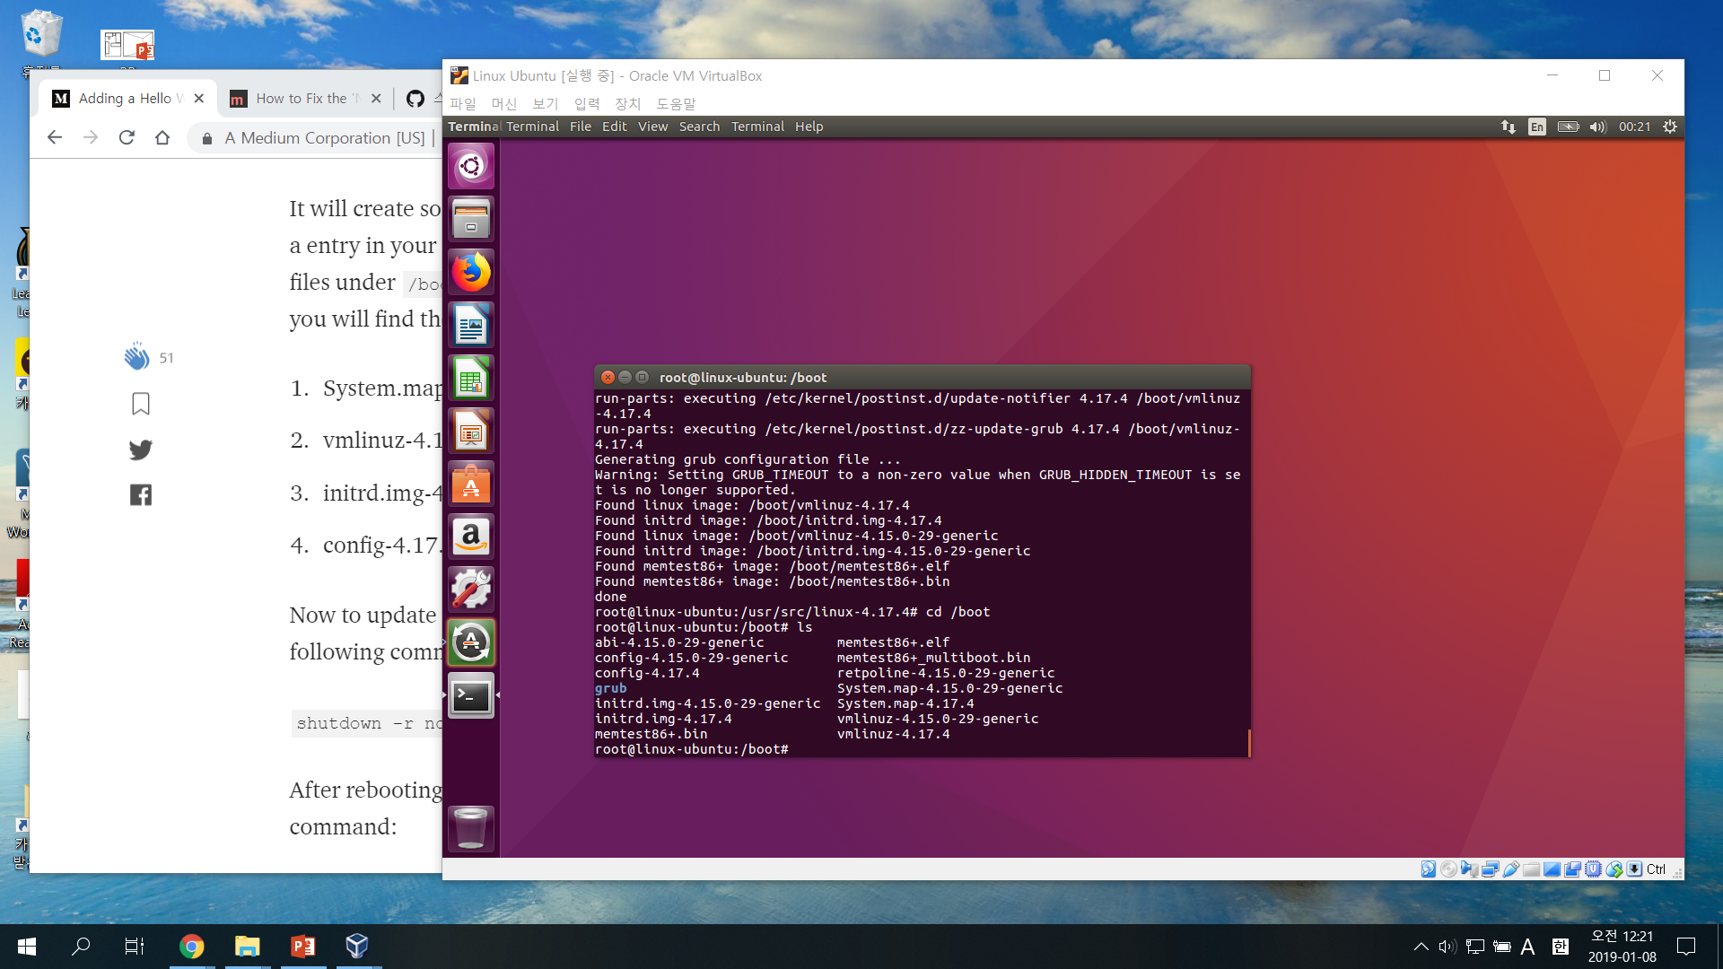
Adding System Call (4/5)
Compile & Update kernel
compile the kernel
use make
update the kernel
use make modules_install install
system.map : symbol table used by the kernel
vmlinuz : statically linked executable file contains the kernel
initrd.img : initial ramdisk image file
config : configure the parameters and initial setting for programs

Slide 8
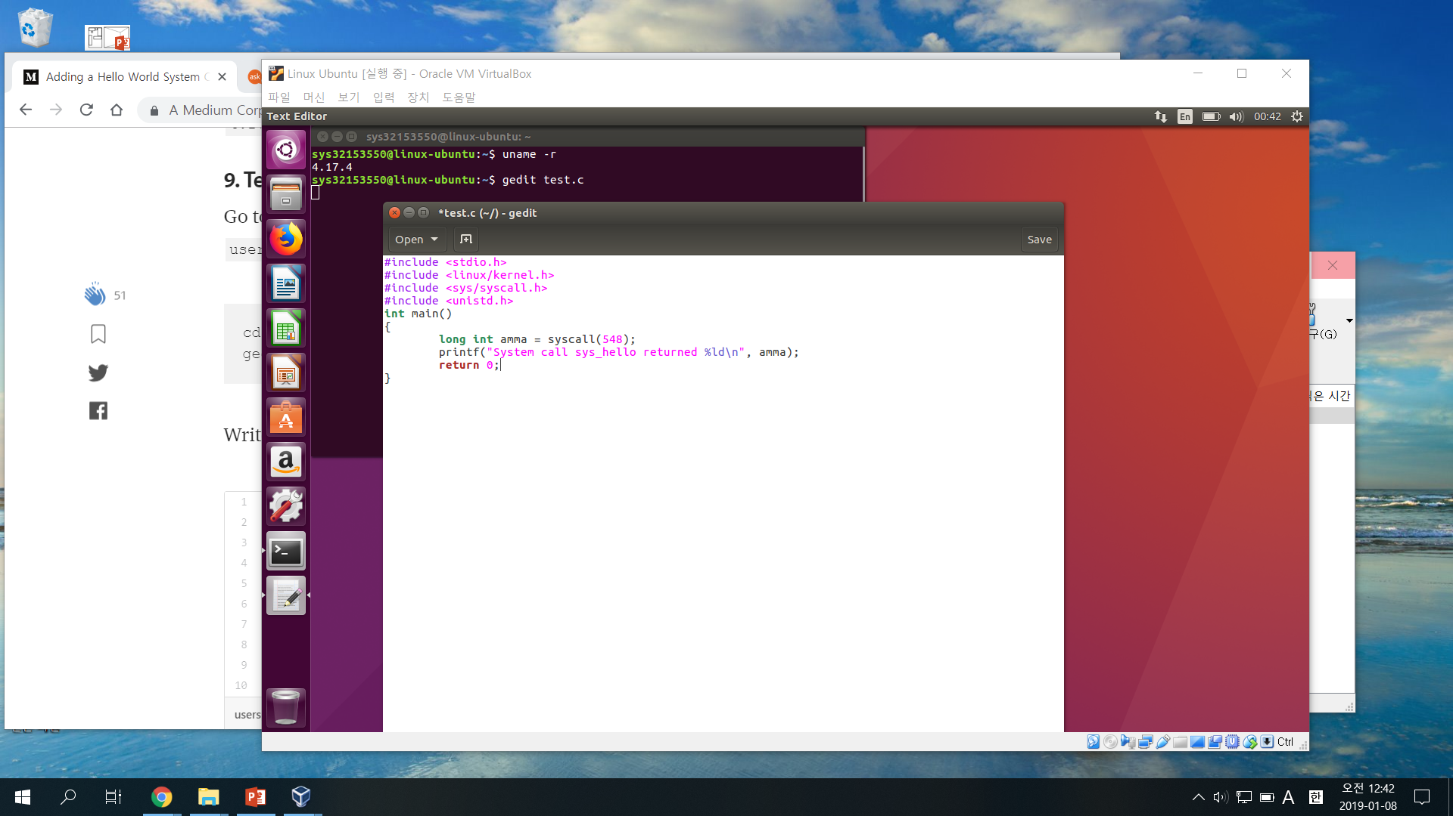
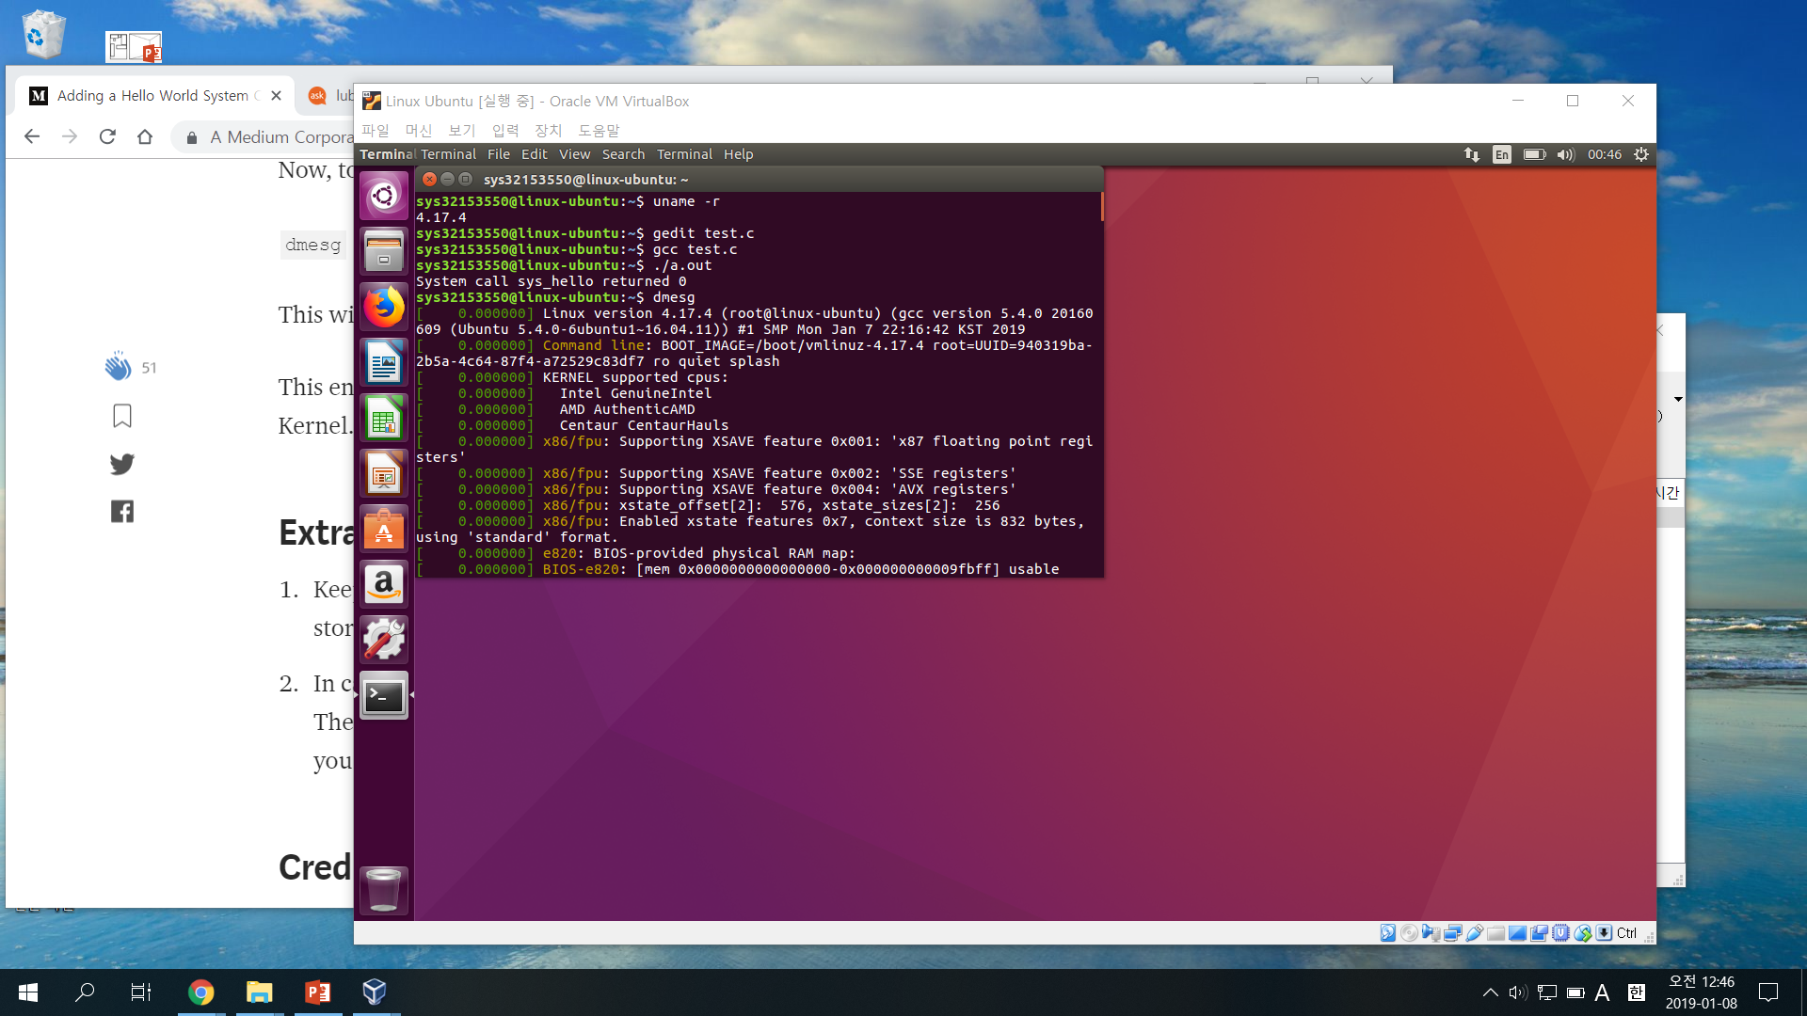

Adding System Call (5/5)
Test System Call

